Slide 1
Module 6: Device Monitoring and Management
Networking Security v1.0
(NETSEC)
Notes:
Networking Security (NETSEC) Module 6: 6: Device Monitoring and Management

Slide 2
Module Objectives
Module Title: Device Monitoring and Management
Module Objective: Implement the secure management and monitoring of network devices.
Topic Title | Topic Objective
Secure Cisco IOS Image and Configuration Files | Explain how the Cisco IOS resilient configuration feature and Secure Copy are used to secure the Cisco IOS image and configuration files.
Lock Down a Router Using AutoSecure | Use the correct commands for AutoSecure to enable security on IOS-based routers.
Routing Protocol Authentication | Use the correct command to configure routing protocol authentication.
Secure Management and Reporting | Compare in-band and out-of-band management access.
Network Security Using Syslog | Explain how to configure syslog to log system events.
NTP Configuration | Configure NTP to enable accurate timestamping between all devices.
SNMP Configuration | Configure SNMP to monitor system status.
Notes:
2

Slide 3
6.1 Secure Cisco IOS Image and Configuration Files
Notes:
6: Device Monitoring and Management 6.1: Secure Cisco IOS Image and Configuration Files

Slide 4
Secure Cisco IOS Image and Configuration Files
Cisco IOS Resilient Configuration Feature
The Cisco IOS resilient configuration feature allows for faster recovery if someone maliciously or unintentionally reformats flash memory or erases the startup configuration file in nonvolatile random-access memory (NVRAM).
The configuration file in the primary bootset is a copy of the running configuration that was in the router when the feature was first enabled.
The feature secures the smallest working set of files to preserve persistent storage space.
No extra space is required to secure the primary Cisco IOS image file. The feature automatically detects image or configuration version mismatch.
Only local storage is used for securing files.
The feature can be disabled only through a console session.
Notes:
6: Device Monitoring and Management 6.1: Secure Cisco IOS Image and Configuration Files 6.1.1: Cisco IOS Resilient Configuration Feature

Slide 5
Secure Cisco IOS Image and Configuration Files
Enabling the IOS Image Resilience Feature
To secure the IOS image and enable Cisco IOS image resilience, use the secure boot-image global configuration mode command. When enabled for the first time, the running Cisco IOS image is secured, and a log entry is generated.
The Cisco IOS image resilience feature can only be disabled through a console session using the no form of the command. Use the show secure bootset command to verify the existence of the archive.
Notes:
6: Device Monitoring and Management 6.1: Secure Cisco IOS Image and Configuration Files 6.1.2: Enabling the IOS Image Resilience Feature

Slide 6
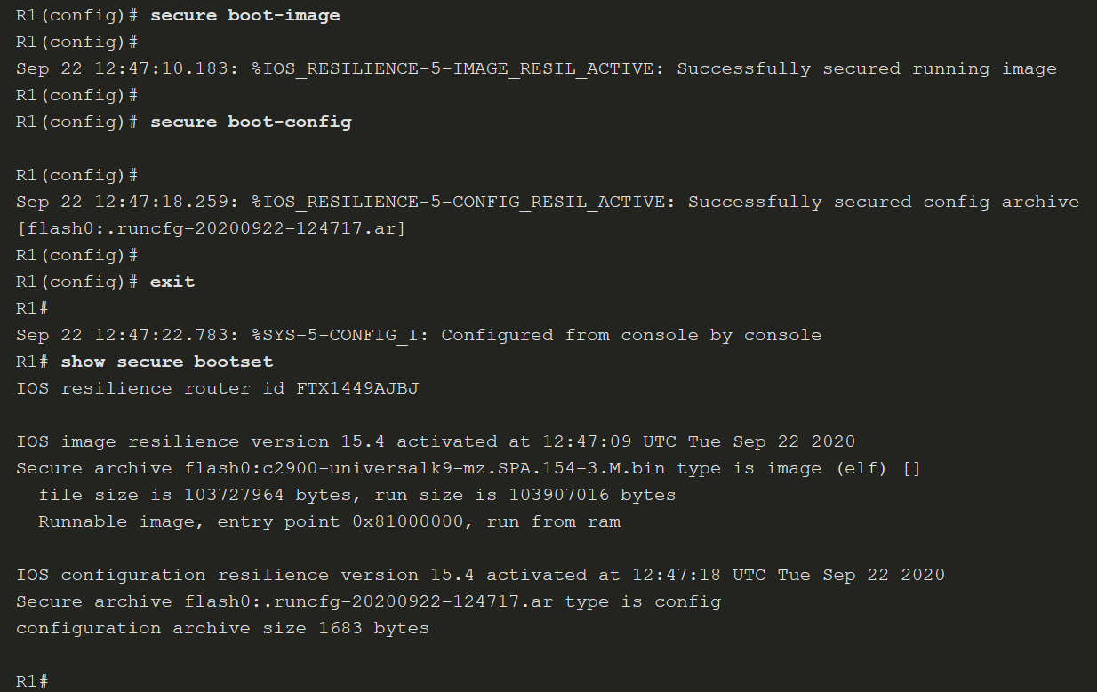
Secure Cisco IOS Image and Configuration Files
Enabling the IOS Image Resilience Feature (Cont.)
Notes:
6: Device Monitoring and Management 6.1: Secure Cisco IOS Image and Configuration Files 6.1.2: Enabling the IOS Image Resilience Feature

Slide 7
Secure Cisco IOS Image and Configuration Files
The Primary Bootset Image
Restore a primary bootset from a secure archive after the router has been tampered with, as follows:
Step 1. Reload the router using the reload command. If necessary, issue the break sequence to enter ROM monitor (ROMmon) mode.
Step 2. From ROMmon mode, enter the dir command to list the contents of the device that contains the secure bootset file.
Step 3. Boot the router with the secure bootset image using the boot command followed by the flash memory location (e.g. flash0), a colon, and the filename found in Step 2.
Step 4. Enter global configuration mode and restore the secure configuration to a filename of your choice using the secure boot-config restore command followed by the flash memory location (e.g. flash0), a colon, and a filename of your choice. In the figure, the filename rescue-cfg is used.
Step 5. Exit global configuration mode and issue the copy command to copy the rescued configuration file to the running configuration.
Notes:
6: Device Monitoring and Management 6.1: Secure Cisco IOS Image and Configuration Files 6.1.3: The Primary Bootset Image

Slide 8
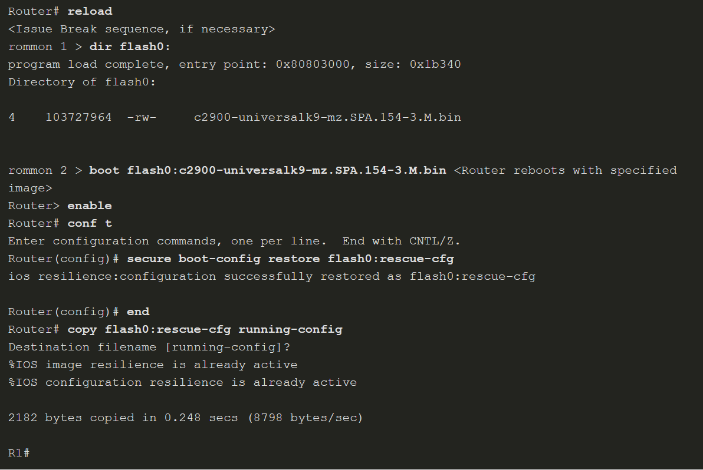
Secure Cisco IOS Image and Configuration Files
The Primary Bootset Image (Cont.)
Notes:
6: Device Monitoring and Management 6.1: Secure Cisco IOS Image and Configuration Files 6.1.3: The Primary Bootset Image

Slide 9
Secure Cisco IOS Image and Configuration Files
Configuring Secure Copy
The Secure Copy Protocol (SCP) feature is used to remotely copy IOS and configuration files. SCP provides a secure and authenticated method for copying router configuration or router image files to a remote location. SRC relies on SCP relies on SSH to secure communication and AAA to provide authentication and authorization.
Configure the router for server-side SCP with local AAA:
Step 1. Configure SSH, if not already configured.
Step 2. For local authentication, configure at least one local database user with privilege level 15.
Step 3. Enable AAA with the aaa new-model global configuration mode command.
Step 4. Use the aaa authentication login default local command to specify that the local database be used for authentication.
Step 5. Use the aaa authorization exec default local command to configure command authorization. In this example, all local users will have access to EXEC commands.
Step 6. Enable SCP server-side functionality with the ip scp server enable command.
Notes:
6: Device Monitoring and Management 6.1: Secure Cisco IOS Image and Configuration Files 6.1.4: Configuring Secure Copy

Slide 10
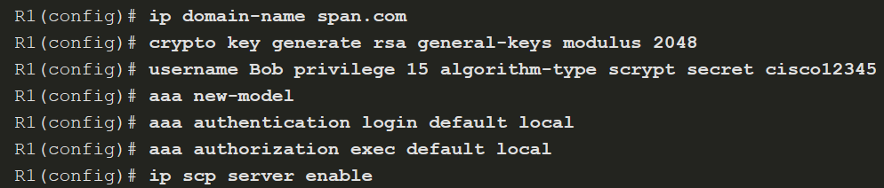
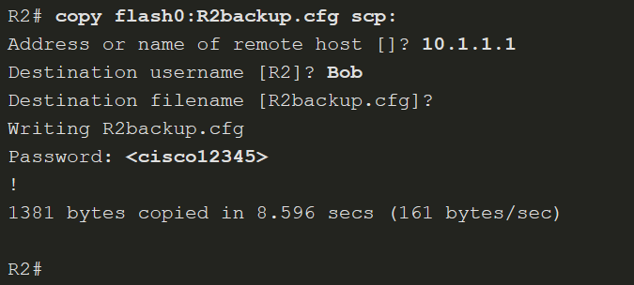
Secure Cisco IOS Image and Configuration Files
Configuring Secure Copy (Cont.)
Notes:
6: Device Monitoring and Management 6.1: Secure Cisco IOS Image and Configuration Files 6.1.4: Configuring Secure Copy

Slide 11
Secure Cisco IOS Image and Configuration Files
Recover a Router Password
Recover Router Passwords Steps
Step 1. | Connect to the console port.
Step 2. | Record the configuration register setting.
Step 3. | Power cycle the router.
Step 4. | Issue the break sequence.
Step 5. | Change the default configuration register with the confreg 0x2142 command.
Step 6. | Reboot the router.
Step 7. | Press Ctrl-C to skip the initial setup procedure.
Step 8. | Put the router into privileged EXEC mode.
Step 9. | Copy the startup configuration to the running configuration.
Step 10. | Verify the configuration.
Step 11. | Change the enable secret password.
Step 12. | Enable all interfaces.
Step 13. | Return the configuration-register to the original setting recorded from Step 2. Use the config-register global config command.
Step 14. | Save the configuration changes.
If a router is compromised or needs to be recovered from a misconfigured password, an administrator must use password recovery procedures, such as those shown in the table.
Notes:
6: Device Monitoring and Management 6.1: Secure Cisco IOS Image and Configuration Files 6.1.5: Recovering a Router Password

Slide 12
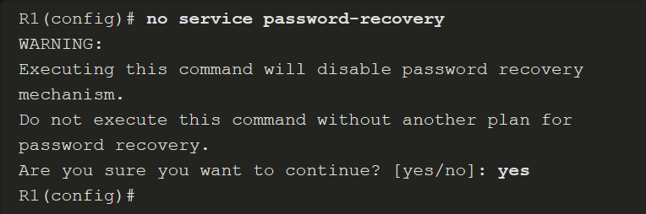
Secure Cisco IOS Image and Configuration Files
Password Recovery
If someone gained physical access to a router, they could potentially gain control of that device through the password recovery procedure.
An administrator can mitigate this potential security breach by using the no service password-recovery global configuration mode command. This command is a hidden Cisco IOS command and has no arguments or keywords. When the no service password-recovery command is entered, a warning message displays and must be acknowledged before the feature is enabled, as shown in the figure.
Notes:
6: Device Monitoring and Management 6.1: Secure Cisco IOS Image and Configuration Files 6.1.6: Password Recovery

Slide 13
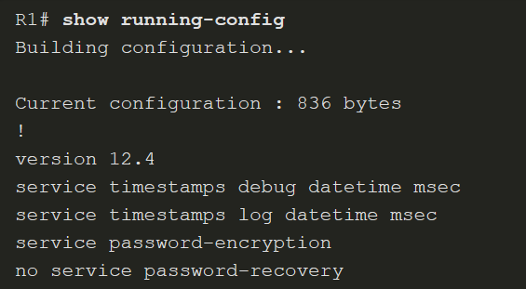
Secure Cisco IOS Image and Configuration Files
Password Recovery (Cont.)
When it is configured, the show running-config command displays a no service password-recovery statement, as shown here.
Notes:
6: Device Monitoring and Management 6.1: Secure Cisco IOS Image and Configuration Files 6.1.6: Password Recovery

Slide 14
Secure Cisco IOS Image and Configuration Files
Password Recovery (Cont.)
To recover a device after the no service password-recovery command is entered, initiate the break sequence within five seconds after the image decompresses during the boot.
You are prompted to confirm the break key action. After the action is confirmed, the startup configuration is completely erased, the password recovery procedure is enabled, and the router boots with the factory default configuration.
If you do not confirm the break action, the router boots normally with the no service password-recovery command enabled.

Slide 15
6.2 Lock Down a Router Using AutoSecure
Notes:
6: Device Monitoring and Management 6.2: Lock Down a Router Using AutoSecure

Slide 16
Lock Down a Router Using AutoSecure
Discovery Protocols CDP and LLDP
Some of the default services can make the device vulnerable to attack if security is not enabled.
The Cisco Discovery Protocol (CDP) is an example of a service that is enabled by default on Cisco routers.
The Link Layer Discovery Protocol (LLDP) is an open standard that can be enabled on Cisco devices, as well as other vendor devices that support LLDP.
The intent of CDP and LLDP is to make it easier for administrators to discover and troubleshoot other devices on the network. However, because of the security implications, these discovery protocols should be used with caution.
Edge devices are an example of a device that should have this feature disabled.
Notes:
6: Device Monitoring and Management 6.2: Lock Down a Router Using AutoSecure 6.2.1: Discovery Protocols CDP and LLDP

Slide 17
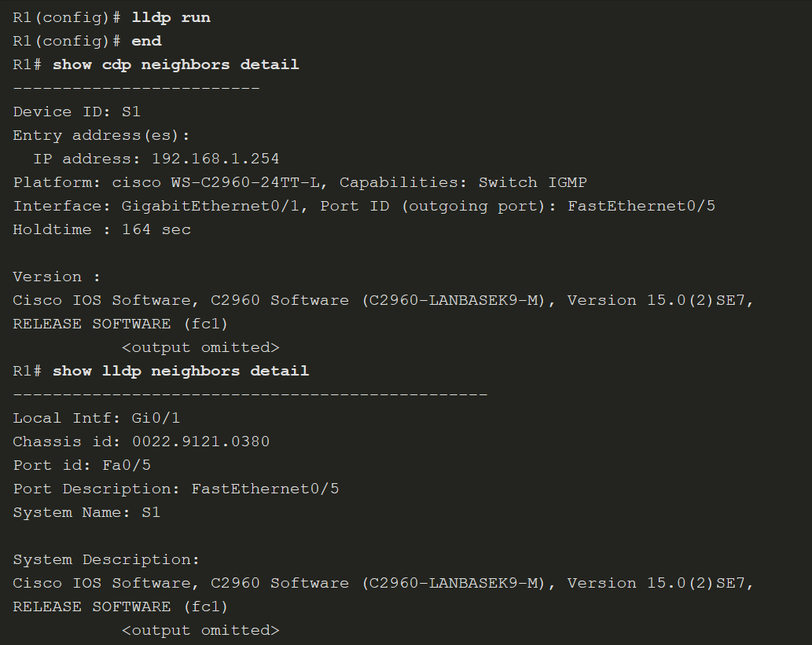
Lock Down a Router Using AutoSecure
Discovery Protocols CDP and LLDP (Cont.)
LLDP configuration and verification is similar to CDP.
Notes:
6: Device Monitoring and Management 6.2: Lock Down a Router Using AutoSecure 6.2.1: Discovery Protocols CDP and LLDP

Slide 18
Lock Down a Router Using AutoSecure
Settings for Protocols and Services
Attackers choose services and protocols that make the network more vulnerable to malicious exploitation. Many of these features should be disabled or restricted in their capabilities based on the security needs of an organization. These features range from network discovery protocols, such as CDP and LLDP, to globally available protocols such as ICMP and other scanning tools.
The table summarizes the feature and default settings for protocols and services.
Feature | Default
Cisco Discovery Protocol (CDP) | Enabled
Link Layer Discovery Protocol (LLDP) | Disabled
Configuration autoloading | Disabled
FTP server | Disabled
TFTP server | Disabled
Network Time Protocol (NTP) service | Disabled
Packet assembler/disassembler (PAD) service | Enabled
TCP and User Datagram Protocol (UDP) minor services | Enabled in versions 11.3 and later
Maintenance Operation Protocol (MOP) service | Enabled on most Ethernet interfaces
Notes:
6: Device Monitoring and Management 6.2: Lock Down a Router Using AutoSecure 6.2.2: Settings for Protocols and Services

Slide 19
Lock Down a Router Using AutoSecure
Settings for Protocols and Services (Cont.)
Feature | Default
Simple Network Management Protocol (SNMP) | Enabled
HTTP or HTTPS configuration and monitoring | Setting is Cisco device dependent.
Domain Name System (DNS) | Enabled
Internet Control Message Protocol (ICMP) redirects | Enabled
IP source routing | Enabled
Finger service | Enabled
ICMP unreachable notifications | Enabled
ICMP mask reply | Disabled
IP identification service | Enabled
TCP keepalives | Disabled
Gratuitous ARP (GARP) | Enabled
Proxy ARP | Enabled
Notes:
6: Device Monitoring and Management 6.2: Lock Down a Router Using AutoSecure 6.2.2: Settings for Protocols and Services

Slide 20
Lock Down a Router Using AutoSecure
Settings for Protocols and Services (Cont.)
The table below shows recommended security settings for protocols and services.
Feature | Recommendation
Link Layer Discovery Protocol (LLDP) | Should be disabled globally or on a per-interface basis if it is not required.
Configuration autoloading | Should remain disabled when not in use by the router.
FTP server | Should be disabled when it is not required.
TFTP server | It should be disabled when it is not required.
Network Time Protocol (NTP) service | It should remain disabled when it is not required.
Packet assembler/disassembler (PAD) service | It should be explicitly disabled when not in use.
TCP and User Datagram Protocol (UDP) minor services | Disable this service explicitly.
Maintenance Operation Protocol (MOP) service | It should be explicitly disabled when it is not in use.
Simple Network Management Protocol (SNMP) | Disable this service when it is not required.
HTTP or HTTPS configuration and monitoring | Disable service if it is not required. If this service is required, restrict access to the router HTTP or HTTPS service using access control lists (ACLs).
Domain Name System (DNS) | Disable when it is not required. If the DNS lookup service is required, ensure that you set the DNS server address explicitly.
Notes:
6: Device Monitoring and Management 6.2: Lock Down a Router Using AutoSecure 6.2.2: Settings for Protocols and Services

Slide 21
Lock Down a Router Using AutoSecure
Settings for Protocols and Services (Cont.)
Feature | Recommendation
Internet Control Message Protocol (ICMP) redirects | Disable when it is not required.
IP source routing | Disable this service when it is not required.
Finger service | Disable this service when it is not required.
ICMP unreachable notifications | Disable on interfaces to untrusted networks.
ICMP mask reply | Disable on interfaces to untrusted networks.
IP identification service | Service should be explicitly disabled.
TCP keepalives | Should be enabled globally to manage TCP connections and prevent certain denial of service (DoS) attacks. Service is enabled in Cisco IOS Software releases before Cisco IOS Release 12.0 and is disabled in Cisco IOS Release 12.0 and later. Disable this service when it is not required.
Gratuitous ARP (GARP) | Disable gratuitous ARPs on each router interface unless this service is needed.
Proxy ARP | Disable this service on each interface unless the router is being used as a LAN bridge.
Notes:
6: Device Monitoring and Management 6.2: Lock Down a Router Using AutoSecure 6.2.2: Settings for Protocols and Services

Slide 22
Lock Down a Router Using AutoSecure
Cisco AutoSecure
AutoSecure can lock down the management plane functions and the forwarding plane services and functions of a router. There are several management plane services and functions:
Secure BOOTP, CDP, FTP, TFTP, PAD, UDP, and TCP small servers, MOP, ICMP (redirects, mask-replies), IP source routing, Finger, password encryption, TCP keepalives, gratuitous ARP, proxy ARP, and directed broadcast
Legal notification using a banner
Secure password and login functions
Secure NTP
Secure SSH access
TCP intercept services
There are three forwarding plane services and functions that AutoSecure enables:
Cisco Express Forwarding (CEF)
Traffic filtering with ACLs
Cisco IOS firewall inspection for common protocols
Notes:
6: Device Monitoring and Management 6.2: Lock Down a Router Using AutoSecure 6.2.3: Cisco AutoSecure

Slide 23

Lock Down a Router Using AutoSecure
Cisco AutoSecure Command Syntax
Use the auto secure command to enable the Cisco AutoSecure feature setup. This setup can be interactive or non-interactive. The figure shows the command syntax for the auto secure command.
Parameter | Description
no-interact | (Optional) The user will not be prompted for any interactive configurations. No interactive dialogue parameters will be configured, including usernames or passwords.
forwarding | (Optional) Only the forwarding plane will be secured.
management | (Optional) Only the management plane will be secured.
Notes:
6: Device Monitoring and Management 6.2: Lock Down a Router Using AutoSecure 6.2.4: Using the Cisco AutoSecure Feature

Slide 24
Lock Down a Router Using AutoSecure
Using the auto secure Command
When the auto secure command is initiated, a CLI wizard steps the administrator through the configuration of the device. User input is required.
Step 1. The auto secure command is entered. The router displays the AutoSecure configuration wizard welcome message.
Step 2. The wizard gathers information about the outside interfaces.
Step 3. AutoSecure secures the management plane by disabling unnecessary services.
Step 4. AutoSecure prompts for a banner.
Step 5. AutoSecure prompts for passwords and enables password and login features.
Step 6. Interfaces are secured.
Step 7. The forwarding plane is secured.
AutoSecure should be used when a router is initially being configured. It is not recommended on production routers.
Notes:
6: Device Monitoring and Management 6.2: Lock Down a Router Using AutoSecure 6.2.5: Using the auto secure Command
6.2.6: Syntax Checker - Using the auto secure Command

Slide 25
Lock Down a Router Using AutoSecure
Lab - Configure Automated Security Features
In this lab, you will complete the following objectives:
Part 1: Configure basic device settings.
Part 2: Configure automated security features.

Slide 26
6.3 Routing Protocol Authentication
Notes:
6: Device Monitoring and Management 6.3: Routing Protocol Authentication

Slide 27
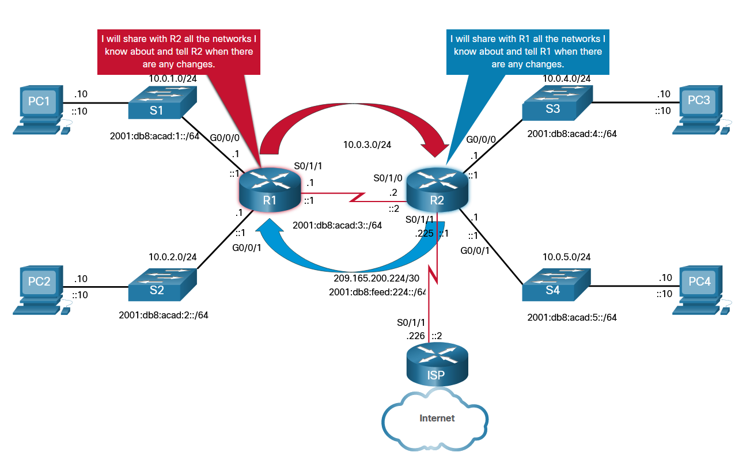
Routing Protocol Authentication
Dynamic Routing Protocols
Dynamic routing protocols perform several activities: including network discovery and maintaining routing tables.
Important advantages of dynamic routing protocols are the ability to select a best path, and the ability to automatically discover a new best path when there is a change in the topology.
A dynamic routing protocol allows the routers to automatically learn about these networks from other routers.
The figure shows routers R1 and R2 using a common routing protocol to share network information.
Notes:
6: Device Monitoring and Management 6.3: Routing Protocol Authentication 6.3.1: Dynamic Routing Protocols

Slide 28
Routing Protocol Authentication
Routing Protocol Spoofing
Routing systems can be attacked by disrupting peer network routers, or by falsifying or spoofing the information carried within the routing protocols. Spoofing routing information may generally be used to cause systems to misinform (lie to) each other, cause a DoS attack, or cause traffic to follow a path it would not normally follow.
There are several consequences of routing information being spoofed:
Redirecting traffic to create routing loops
Redirecting traffic so it can be monitored on an insecure link
Redirecting traffic to discard it
Notes:
6: Device Monitoring and Management 6.3: Routing Protocol Authentication 6.3.2: Routing Protocol Spoofing

Slide 29
Routing Protocol Authentication
OSPF MD5 Routing Protocol Authentication
Enable OSPF MD5 authentication globally:
ip ospf message-digest-key key md5 password interface configuration command.
area area-id authentication message-digest router configuration command.
This method forces authentication on all OSPF enabled interfaces. If an interface is not configured with the ip ospf message-digest-key command, it will not be able to form adjacencies with other OSPF neighbors.
Enable MD5 authentication on a per interface basis:
ip ospf message-digest-key key md5 password interface configuration command.
ip ospf authentication message-digest interface configuration command.
Notes:
6: Device Monitoring and Management 6.3: Routing Protocol Authentication 6.3.3: OSPF MD5 Routing Protocol Authentication

Slide 30
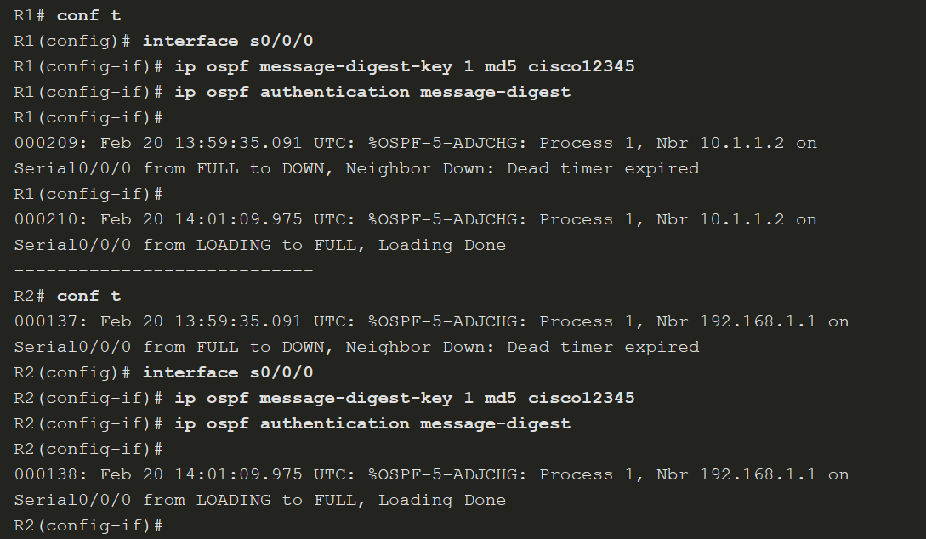
Routing Protocol Authentication
OSPF MD5 Routing Protocol Authentication (Cont.)
Notes:
6: Device Monitoring and Management 6.3: Routing Protocol Authentication 6.3.3: OSPF MD5 Routing Protocol Authentication

Slide 31
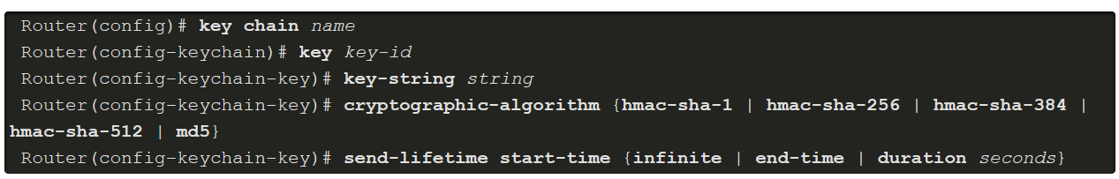
Routing Protocol Authentication
OSPF SHA Routing Protocol Authentication
MD5 is now considered vulnerable to attacks and should only be used when stronger authentication is not available. Administrators should use SHA authentication as long as all of the router operating systems support OSPF SHA authentication.
Step 1. Specify an authentication key chain in global configuration mode:
Configure a key chain name with the key chain command.
Assign the key chain a number and a password with the key and key-string commands.
Specify SHA authentication with the cryptographic-algorithm command.
(Optional) Specify when this key will expire with the send-lifetime command.
Notes:
6: Device Monitoring and Management 6.3: Routing Protocol Authentication 6.3.4: OSPF SHA Routing Protocol Authentication

Slide 32


Routing Protocol Authentication
OSPF SHA Routing Protocol Authentication (Cont.)
Step 2. Assign the authentication key to the desired interfaces with the ip ospf authentication key-chain command.
The next slide shows an SHA authentication example for R1 and R2.
Notes:
6: Device Monitoring and Management 6.3: Routing Protocol Authentication 6.3.4: OSPF SHA Routing Protocol Authentication 6.3.5: Syntax Checker- OSPF SHA Routing Protocol Authentication

Slide 33
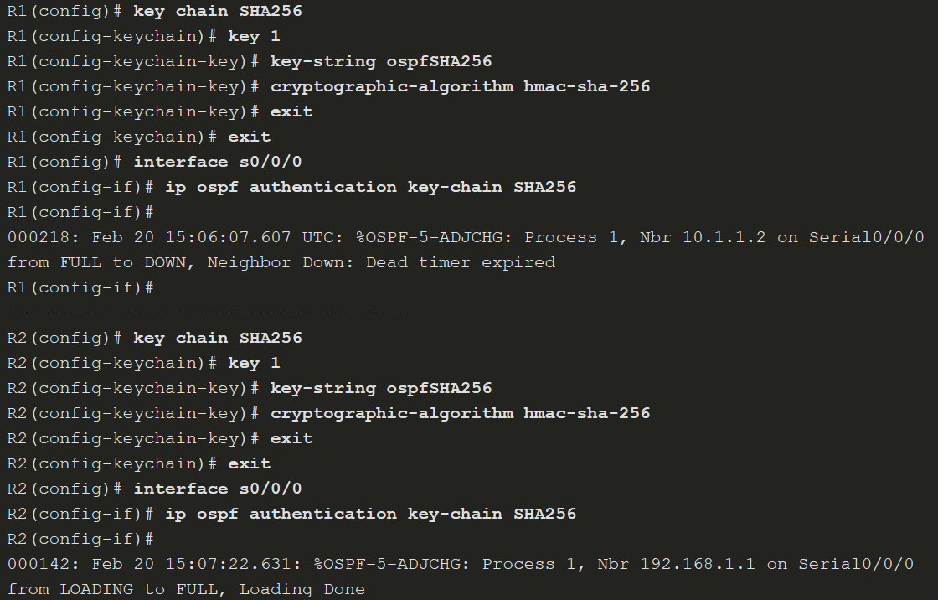
Routing Protocol Authentication
OSPF SHA Routing Protocol Authentication (Cont.)
Notes:
6: Device Monitoring and Management 6.3: Routing Protocol Authentication 6.3.4: OSPF SHA Routing Protocol Authentication 6.3.5: Syntax Checker- OSPF SHA Routing Protocol Authentication

Slide 34
Routing Protocol Authentication
Lab - Basic Device Configuration and OSPF Authentication
In this lab, you will complete the following objectives:
Part 1: Configure basic device settings.
Part 2: Secure the control plane.
Notes:
6: Device Monitoring and Management 6.3: Routing Protocol Authentication 6.3.6 - Lab

Slide 35
Routing Protocol Authentication
Packet Tracer - Configure OSPF Authentication
In this Packet Tracer activity, you will configure OSPF MD5 authentication.
Notes:
6: Device Monitoring and Managements 6.3: Routing Protocol Authentication 6.3.7 PT-Configure OSPF Authentication

Slide 36
6.4 Secure Management and Reporting
Notes:
6: Device Monitoring and Management 6.4: Secure Management and Reporting

Slide 37
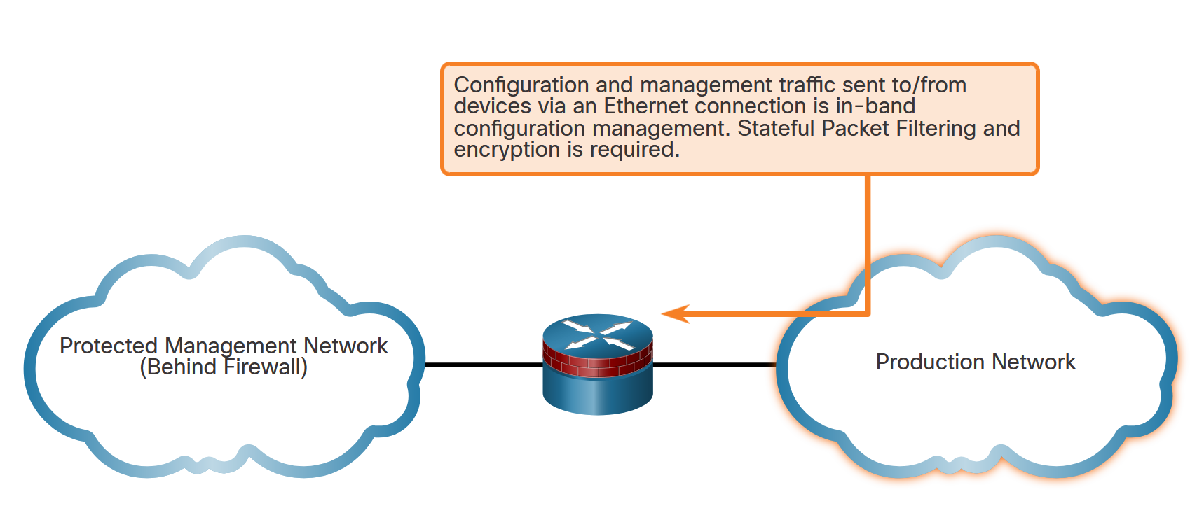
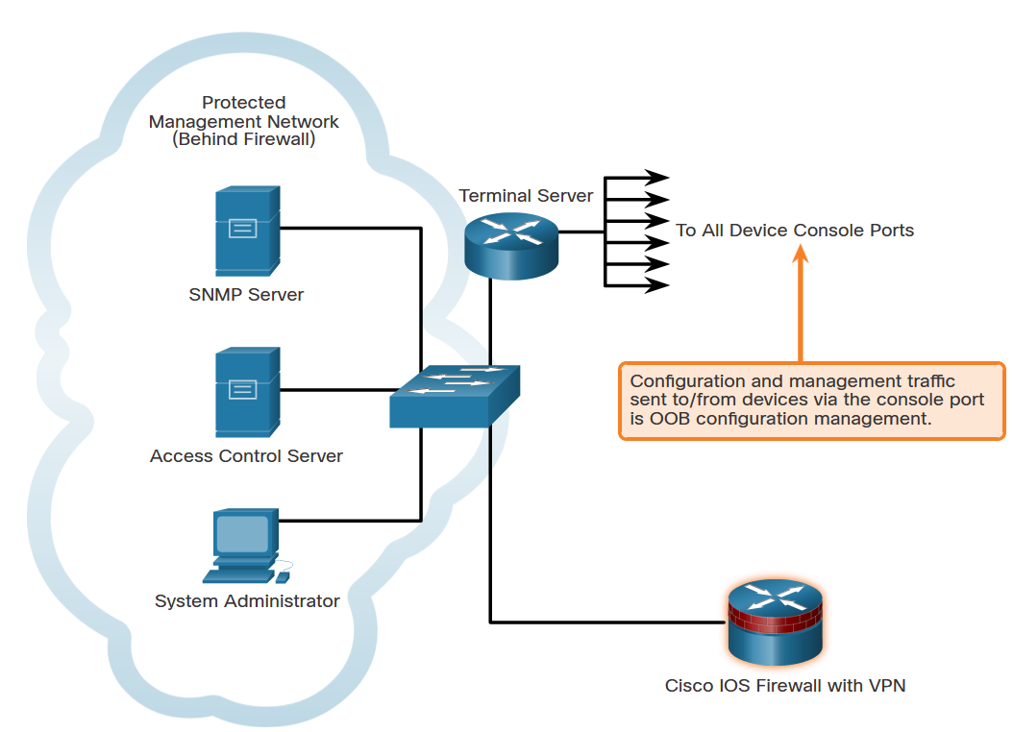
Secure Management and Reporting
Types of Management Access
(From a reporting standpoint, most networking devices can send log data that can be invaluable when troubleshooting network problems or security threats. This data can be viewed in real time, on demand, and in scheduled reports.
When logging and managing information, the information flow between management hosts and the managed devices can take two paths:
In-band - Information flows across an enterprise production network, the Internet, or both, using regular data channels.
Out-of-band (OOB) - Information flows on a dedicated management network on which no production traffic resides.
Notes:
6: Device Monitoring and Management 6.4: Secure Management and Reporting 6.4.1: Determining the Type of Management Access

Slide 38
Secure Management and Reporting
Out-of-Band and In-Band Access
As a general rule, for security purposes, OOB management is appropriate for large enterprise networks. However, it is not always desirable. The decision to use OOB management depends on the type of management applications running and the protocols being monitored.
OOB management guidelines are:
Provide the highest level of security.
Mitigate the risk of passing insecure management protocols over the production network.
In-band management is recommended in smaller networks as a means of achieving a more cost-effective security deployment. In such architectures, management traffic flows in-band in all cases. It is made as secure as possible using secure management protocols, for example using SSH instead of Telnet.
In-band management guidelines are:
Apply only to devices that need to be managed or monitored.
Use IPsec, SSH, or SSL when possible.
Decide whether the management channel needs to be open at all times.
Notes:
6: Device Monitoring and Management 6.4: Secure Management and Reporting 6.4.2: Out-of-Band and In-Band Access

Slide 39
6.5 Network Security Using Syslog
Notes:
6: Device Monitoring and Management 6.5: Network Security Using Syslog

Slide 40
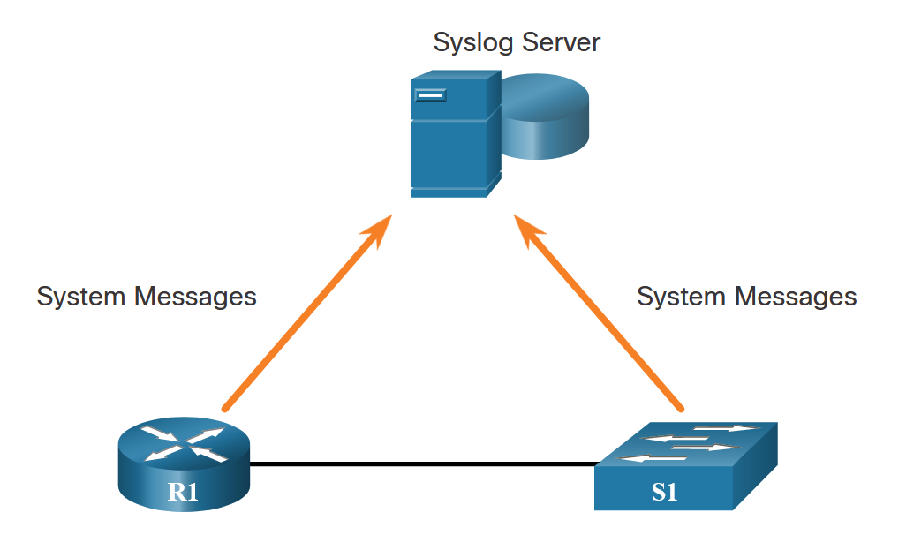
Network Security Using Syslog
Introduction to Syslog
The most common method of accessing system messages is to use a protocol called syslog.
Syslog is a term used to describe a standard. It is also used to describe the protocol developed for that standard. Many networking devices support syslog, including routers, switches, application servers, firewalls, and other network appliances. The syslog protocol allows networking devices to send their system messages across the network to syslog servers.
The syslog logging service provides three primary functions, as follows:
The ability to gather logging information for monitoring and troubleshooting
The ability to select the type of logging information that is captured
The ability to specify the destinations of captured syslog messages
Notes:
6: Device Monitoring and Management 6.5: Network Security Using Syslog 6.5.1: Introduction to Syslog

Slide 41
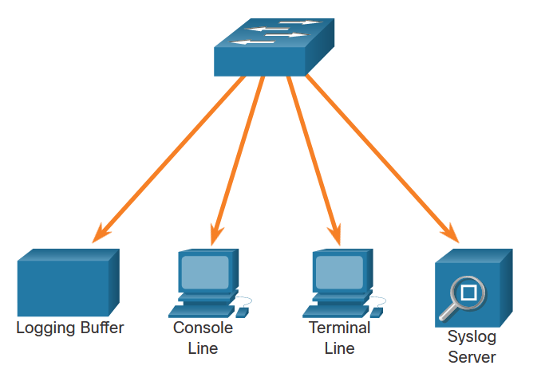
Network Security Using Syslog
Syslog Operation
On Cisco network devices, the syslog protocol starts by sending system messages and debug output to a local logging process that is internal to the device. How the logging process manages these messages and outputs is based on device configurations.
As shown in the figure, popular destinations for syslog messages include the:
Logging buffer (RAM inside a router or switch)
Console line
Terminal line
Syslog server
It is possible to remotely monitor system messages by viewing the logs on a syslog server, or by accessing the device through Telnet, SSH, or through the console port.
Notes:
6: Device Monitoring and Management 6.5: Network Security Using Syslog 6.5.2: Syslog Operation

Slide 42
Network Security Using Syslog
Syslog Message Format
Cisco devices produce syslog messages as a result of network events. Every syslog message contains a severity level and a facility.
The smaller numerical levels are the more critical syslog alarms.
Severity Name | Severity Level | Description
Emergency | Level 0 | System Unusable
Alert | Level 1 | Immediate Action Needed
Critical | Level 2 | Critical Condition
Error | Level 3 | Error Condition
Warning | Level 4 | Warning Condition
Notification | Level 5 | Normal, but Significant Condition
Informational | Level 6 | Informational Message
Debugging | Level 7 | Debugging Message
Notes:
6: Device Monitoring and Management 6.5: Network Security Using Syslog 6.5.3: Syslog Message Format

Slide 43


Network Security Using Syslog
Syslog Facilities
Syslog facilities are service identifiers that identify and categorize system state data for error and event message reporting. The logging facility options that are available are specific to the networking device.
By default, the format of syslog messages on the Cisco IOS Software is as follows:
For example, sample output on a Cisco switch for an EtherChannel link changing state to up is:
Here the facility is LINK and the severity level is 3, with a MNEMONIC of UPDOWN
Notes:
6: Device Monitoring and Management 6.5: Network Security Using Syslog 6.5.4: Syslog Facilities

Slide 44
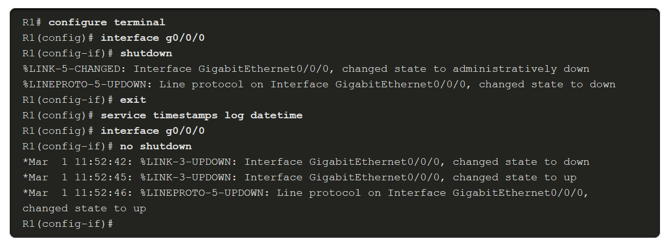
Network Security Using Syslog
Configure Syslog Timestamps
By default, log messages are not timestamped. Log messages should be timestamped so that when they are sent to another destination, such as a Syslog server, there is record of when the message was generated.
Use the command service timestamps log datetime to force logged events to display the date and time. As shown in the command output, when the R1 GigabitEthernet 0/0/0 interface is reactivated, the log messages now contain the date and time.
Notes:
6: Device Monitoring and Management 6.5: Network Security Using Syslog 6.5.5: Configure Syslog Timestamps
6.5.6: Check Your Understanding - Syslog Operation

Slide 45
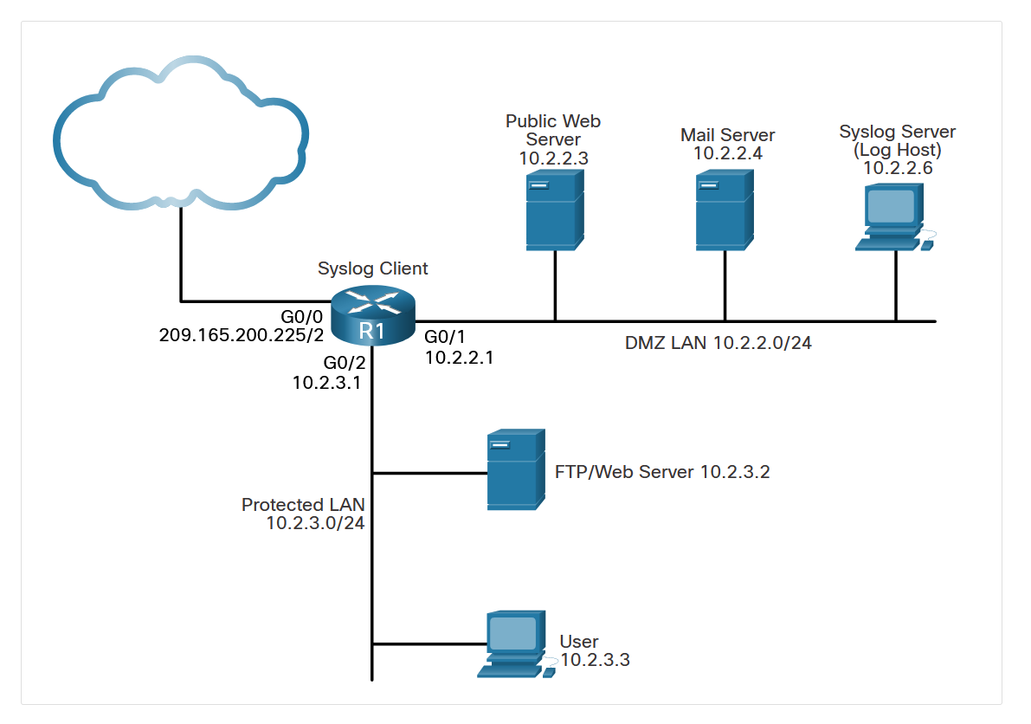
Network Security Using Syslog
Syslog Systems
Syslog implementations always contain two types of systems:
Syslog servers - Also known as log hosts, these systems accept and process log messages from syslog clients.
Syslog clients - Routers or other types of equipment that generate and forward log messages to syslog servers.
The topology in the figure identifies the syslog server at IP address 10.2.2.6. The rest of the servers and devices in the topology can be configured as syslog clients, which send syslog messages to the syslog server.
Notes:
6: Device Monitoring and Management 6.5: Network Security Using Syslog 6.5.7: Syslog Systems

Slide 46
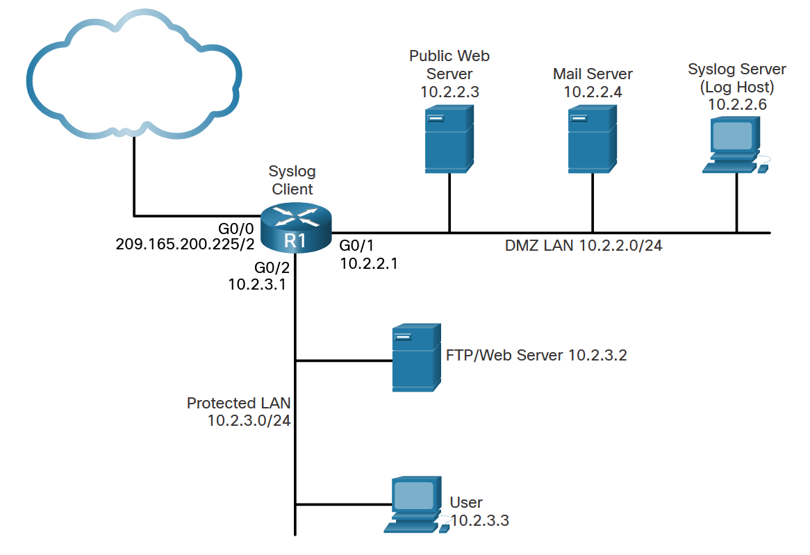
Network Security Using Syslog
Syslog Configuration
Configure system logging with the following steps:
Step 1. Set the destination logging host using the logging [host] command.
Step 2. (Optional) Set the log severity (trap) level using the logging trap command.
Step 3. (Optional) Set the source interface using the logging source-interface command.
Step 4. (Optional) Enable logging to all enabled destinations with the logging on command.
The figure shows the syslog reference topology.
Notes:
6: Device Monitoring and Management 6.5: Network Security Using Syslog 6.5.8: Configuring System Logging

Slide 47
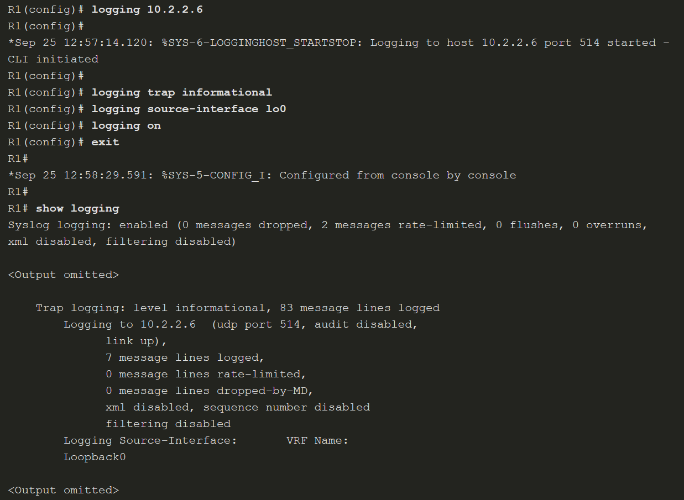
Network Security Using Syslog
Syslog Configuration (Cont.)
Notes:
6: Device Monitoring and Management 6.5: Network Security Using Syslog 6.5.8: Configuring System Logging

Slide 48
6.6 NTP Configuration
Notes:
6: Device Monitoring and Management 6.6: NTP Configuration

Slide 49
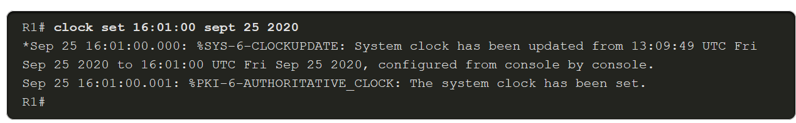
NTP Configuration
Time and Calendar Services
The software clock on a router or switch starts when the system boots. It is the primary source of time for the system. It is important to synchronize the time across all devices on the network because all aspects of managing, securing, troubleshooting, and planning networks require accurate timestamping.
The date and time settings on a router or switch can be manually configured, using the clock set command, as shown in the example.
Notes:
6: Device Monitoring and Management 6.6: NTP Configuration 6.6.1: Time and Calendar Services

Slide 50
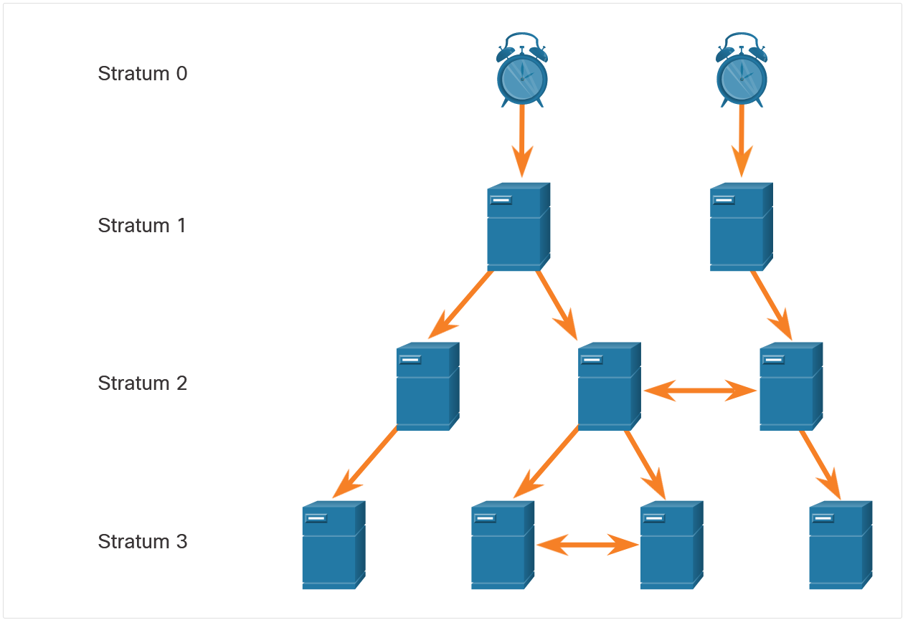
NTP Configuration
NTP Operation
NTP networks use a hierarchical system of time sources. Each level in this hierarchical system is called a stratum. The stratum level is defined as the number of hop counts from the authoritative source.
The sample network consists of four stratum levels who acquire their times as follows:
Stratum 1 server gets its time from the stratum 0 time source.
Stratum 2 server gets its time from the stratum 1 server.
Stratum 3 server gets its time from the stratum 2 server.
Notes:
6: Device Monitoring and Management 6.6: NTP Configuration 6.6.2: NTP Operation

Slide 51
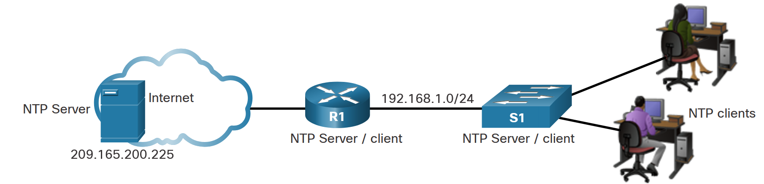
NTP Configuration
Configure and Verify NTP
The figure shows the topology used to demonstrate NTP configuration and verification
Notes:
6: Device Monitoring and Management 6.6: NTP Configuration 6.6.3: Configure and Verify NTP

Slide 52
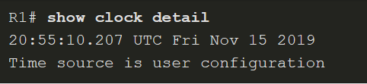
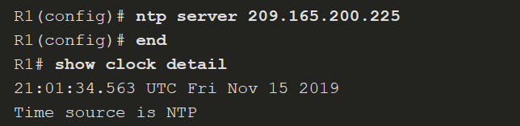
NTP Configuration
Configure and Verify NTP (Cont.)
Before NTP is configured on the network, the show clock detail command displays the time source is user configuration.
Use the ntp server ip-address command to configure a NTP server the device should use as a source. If the source is another Cisco device, it must be configured with the ntp master [stratum] command.
Notes:
6: Device Monitoring and Management 6.6: NTP Configuration 6.6.3: Configure and Verify NTP

Slide 53
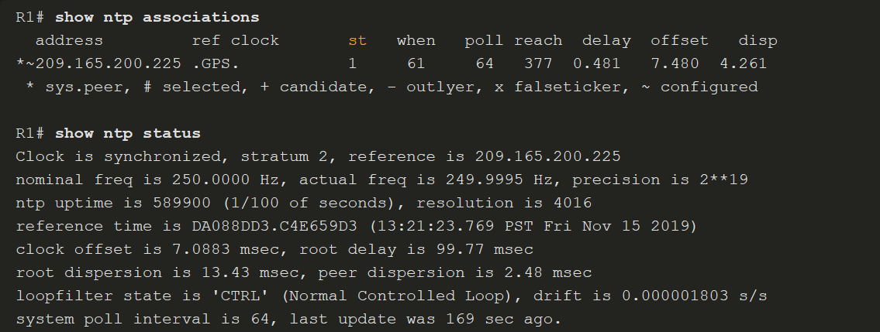
NTP Configuration
Configure and Verify NTP (Cont.)
Use the show ntp associations and show ntp status commands to verify the device is synchronized with the NTP server.
Notes:
6: Device Monitoring and Management 6.6: NTP Configuration 6.6.3: Configure and Verify NTP
6.6.4: Packet Tracer - Configure and Verify NTP

Slide 54
NTP Configuration
Packet Tracer - Configure and Verify NTP
NTP synchronizes the time of day among a set of distributed time servers and clients. While there are a number of applications that require synchronized time, this lab will focus on the need to correlate events when listed in the system logs and other time-specific events from multiple network devices
Notes:
6: Device Monitoring and Management 6.6: NTP Configuration

Slide 55
6.7 SNMP Configuration
Notes:
6: Device Monitoring and Management 6.7: SNMP Configuration

Slide 56
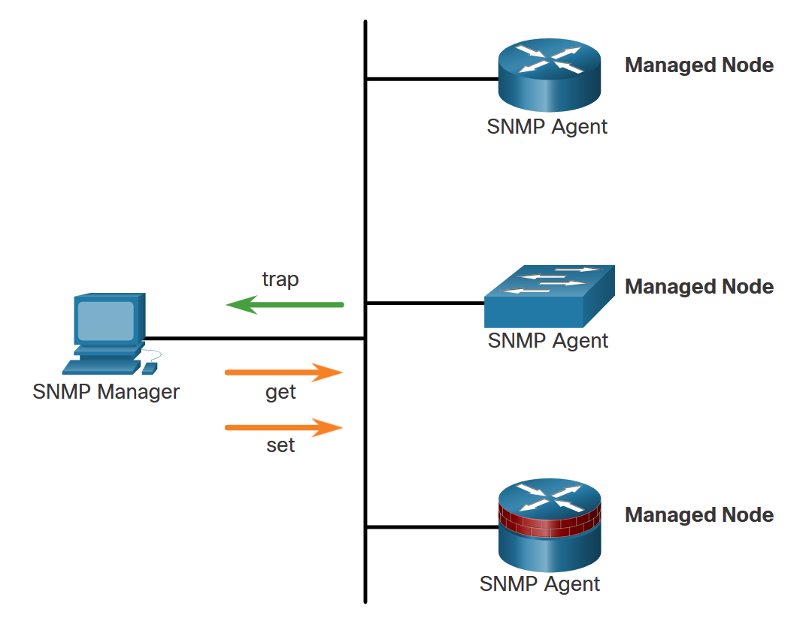
SNMP Configuration
Introduction to SNMP
SNMP is an application layer protocol that provides a message format for communication between managers and agents.
The SNMP system consists of three elements:
SNMP manager
SNMP agents (managed node)
Management Information Base (MIB)
To configure SNMP on a networking device, it is first necessary to define the relationship between the manager and the agent.
The SNMP manager is part of a network management system (NMS). The SNMP manager runs SNMP management software.
As shown in the figure, the SNMP manager can collect information from an SNMP agent by using the “get” action. It can change configurations on an agent by using the “set” action. In addition, SNMP agents can forward information directly to a network manager by using “traps”.
Notes:
6: Device Monitoring and Management 6.7: SNMP Configuration 6.7.1: Introduction to SNMP

Slide 57
SNMP Configuration
SNMP Operation
There are two primary SNMP manager requests:
get request - Used by the NMS to query the device for data.
set request - Used by the NMS to change configuration variables in the agent device. A set request can also initiate actions within a device. For example, a set request can cause a router to reboot, send a configuration file, or receive a configuration file.
The SNMP manager uses the get and set actions to perform the operations described in the table.
get-request | Retrieves a value from a specific variable.
get-next-request | Retrieves a value from a variable within a table; the SNMP manager does not need to know the exact variable name. A sequential search is performed to find the needed variable from within a table.
get-bulk-request | Retrieves large blocks of data, such as multiple rows in a table, that would otherwise require the transmission of many small blocks of data. (Only works with SNMPv2 or later.)
get-response | Replies to a get-request, get-next-request, and set-request sent by an NMS.
set-request | Stores a value in a specific variable.
Notes:
6: Device Monitoring and Management 6.7: SNMP Configuration 6.7.2: SNMP Operation

Slide 58
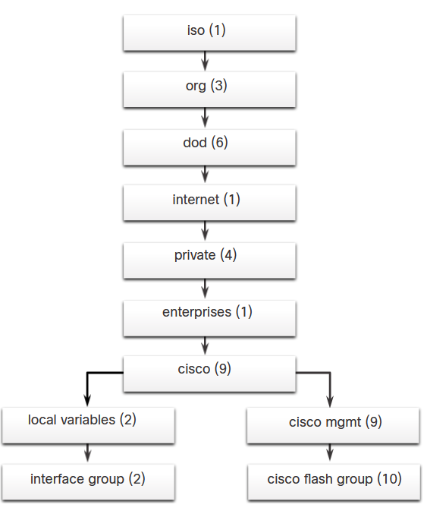
SNMP Configuration
Management Information Base (MIB)
The MIB organizes variables hierarchically. MIB variables enable the management software to monitor and control the network device.
Formally, the MIB defines each variable as an object ID (OID). OIDs uniquely identify managed objects in the MIB hierarchy. The MIB organizes the OIDs based on RFC standards into a hierarchy of OIDs, usually shown as a tree.
The figure shows portions of the MIB structure defined by Cisco. Note how the OID can be described in words or numbers to help locate a particular variable in the tree. OIDs belonging to Cisco, are numbered as follows: .iso (1).org (3).dod (6).internet (1).private (4).enterprises (1).cisco (9). Therefore, the OID is 1.3.6.1.4.1.9.
Notes:
6: Device Monitoring and Management 6.7: SNMP Configuration 6.7.3: Management Information Base (MIB)

Slide 59
SNMP Configuration
SNMP Versions
Here are several versions of SNMP:
SNMPv1 - This is the Simple Network Management Protocol, a Full Internet Standard, that is defined in RFC 1157.
SNMPv2c - This is defined in RFCs 1901 to 1908. It uses a community-string-based Administrative Framework.
SNMPv3 - This is an interoperable standards-based protocol originally defined in RFCs 2273 to 2275. It provides secure access to devices by authenticating and encrypting packets over the network. It includes these security features: message integrity to ensure that a packet was not tampered with in transit, authentication to determine that the message is from a valid source, and encryption to prevent the contents of a message from being read by an unauthorized source.
All versions use SNMP managers, agents, and MIBs. Cisco IOS software supports the above three versions. Both SNMPv1 and SNMPv2c use a community-based form of security. The community of managers that is able to access the MIB of the agent is defined by a community string. SNMPv3 provides for both security models and security levels.
Notes:
6: Device Monitoring and Management 6.7: SNMP Configuration 6.7.4: SNMP Versions

Slide 60
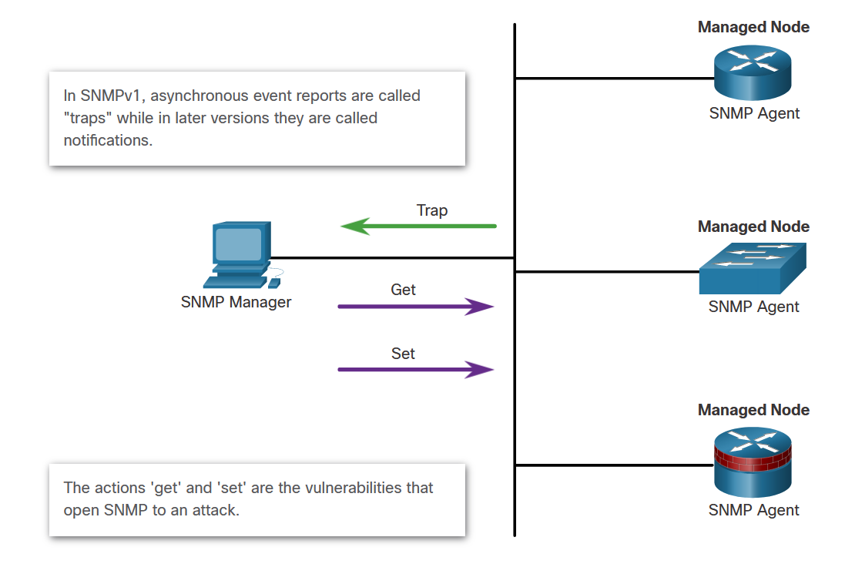
SNMP Configuration
SNMP Vulnerabilities
In any network topology, at least one manager node should run SNMP management software. Network devices that can be managed, such as switches, routers, servers, and workstations, are equipped with the SNMP agent software module.
SNMP is vulnerable to attack precisely because SNMP agents can be polled with get requests and accept configuration changes with set requests, as shown in the figure.
Notes:
6: Device Monitoring and Management 6.7: SNMP Configuration 6.7.5: SNMP Vulnerabilities

Slide 61
SNMP Configuration
SNMPv3
SNMPv3 provides three security features:
Message integrity and authentication - Ensures that a packet has not been tampered with in transit and is from a valid source.
Encryption - Scrambles the contents of a packet to prevent it from being seen by an unauthorized source.
Access control - Restricts each principal to certain actions on specific portions of data.
Notes:
6: Device Monitoring and Management 6.7: SNMP Configuration 6.7.6: SNMPv3

Slide 62



SNMP Configuration
SNMPv3 Security Configuration
SNMPv3 can be secured with only a few commands:
Step 1. Configure an ACL that will permit access to authorized SNMP managers.
Step 2. Configure an SNMP view with the snmp-server view command to identify the MIB OIDs that the SNMP manager will be able to read. Configuring a view is required to limit SNMP messages to read-only access.
Step 3. Configure SNMP group features with the snmp-server group command:
Configure a name for the group.
Set the SNMP version to 3 with the v3 keyword.
Require authentication and encryption with the priv keyword.
Associate a view to the group and give it read only access with the read command.
Specify the ACL configured in Step 1.
Notes:
6: Device Monitoring and Management 6.7: SNMP Configuration 6.7.7: Configuring SNMPv3 Security

Slide 63

SNMP Configuration
SNMPv3 Security Configuration (Cont.)
SNMPv3 can be secured with only a few commands:
Step 4. Configure SNMP group user features with the snmp-server user command:
Configure a username and associate the user with the group name configured in Step 3.
Set the SNMP version to 3 with the v3 keyword.
Set the authentication type to either md5 or sha and configure an authentication password. SHA is preferred and should be supported by the SNMP management software.
Require encryption with the priv keyword and configure an encryption password.
Notes:
6: Device Monitoring and Management 6.7: SNMP Configuration 6.7.7: Configuring SNMPv3 Security

Slide 64
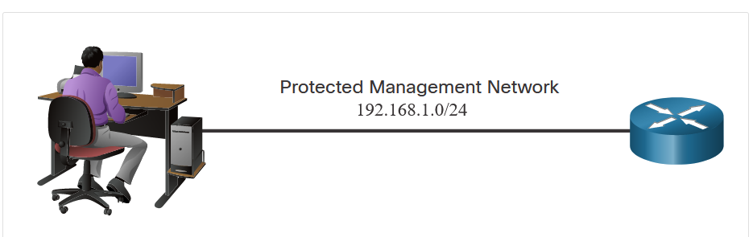
SNMP Configuration
SNMPv3 Security Configuration Example
The figure shows an example configuration for securing SNMPv3.
Step 1. A standard ACL is named PERMIT-ADMIN and is configured to permit only the 192.168.1.0/24 network.
Step 2. An SNMP view is named SNMP-RO and is configured to include the entire iso tree from the MIB.
Step 3. An SNMP group is configured with the name ADMIN, SNMPv3, and access for those allowed with the PERMIT-ADMIN ACL.
Step 4. An SNMP user, BOB, is configured as a member of the group ADMIN using SNMPv3, with SHA authentication, AES 256 encryption, and the encryption password.
Notes:
6: Device Monitoring and Management 6.7: SNMP Configuration 6.7.8: SNMPv3 Security Configuration Example
6.7.9: Syntax Checker – SNMP3 Security Configuration Example

Slide 65
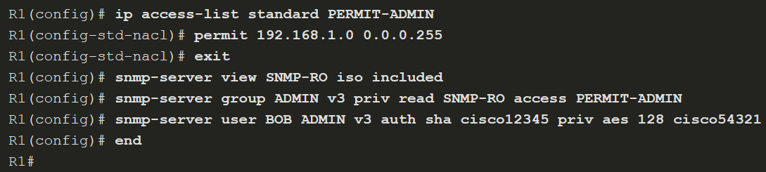
SNMP Configuration
SNMPv3 Verification
Notes:
6: Device Monitoring and Management 6.7: SNMP Configuration 6.7.10: SNMP3 Verification

Slide 66
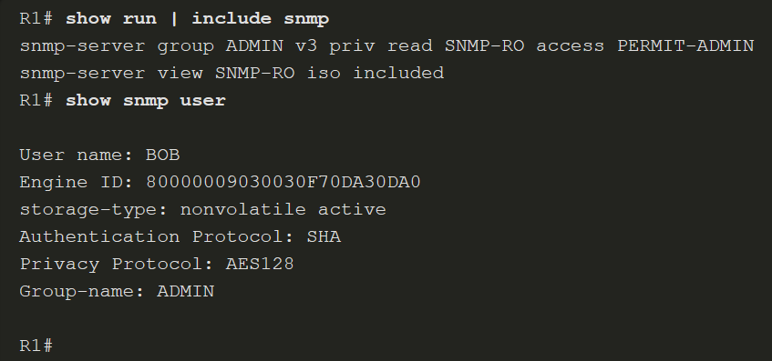
SNMP Configuration
SNMPv3 Verification (Cont.)
Verify most of the SNMPv3 security configuration by viewing the running configuration, as shown in in the figure. Notice that the snmp-server user configuration is hidden. Use the show snmp user command to view the user information.
Notes:
6: Device Monitoring and Management 6.7: SNMP Configuration 6.7.10: SNMPv3 Verification

Slide 67
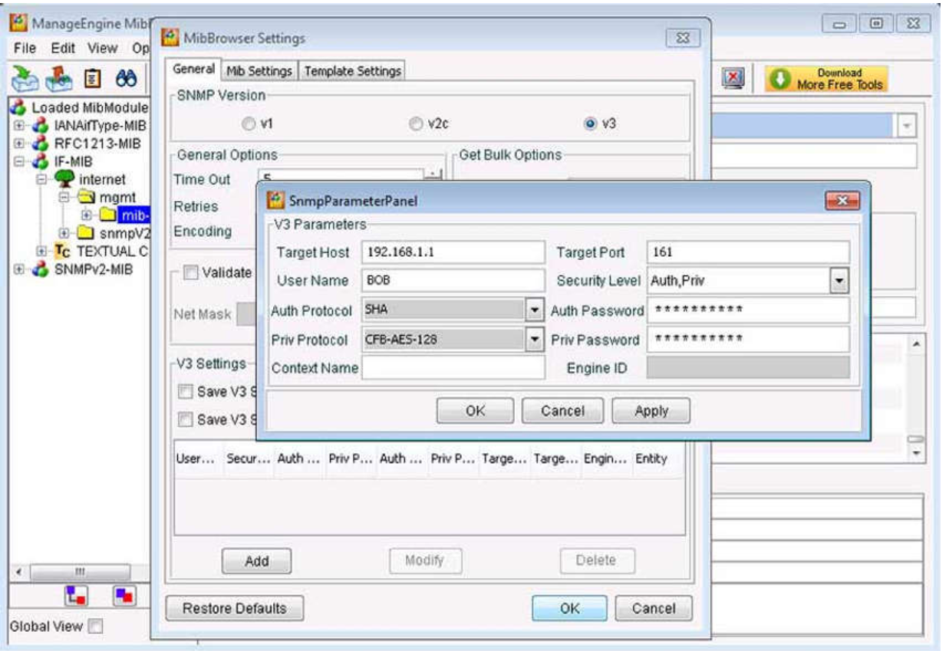
SNMP Configuration
SNMPv3 Verification (Cont.)
Verify that the SNMP manager can send get requests to R1 by using an SNMP management tool, such as the ManageEngine’s free SNMP MIB Browser. Configure the tool with the user details. When a user is configured, use the SNMP management tool’s features to test that the configured user can access the SNMP agent.
Notes:
6: Device Monitoring and Management 6.7: SNMP Configuration 6.7.10: SNMPv3 Verification

Slide 68
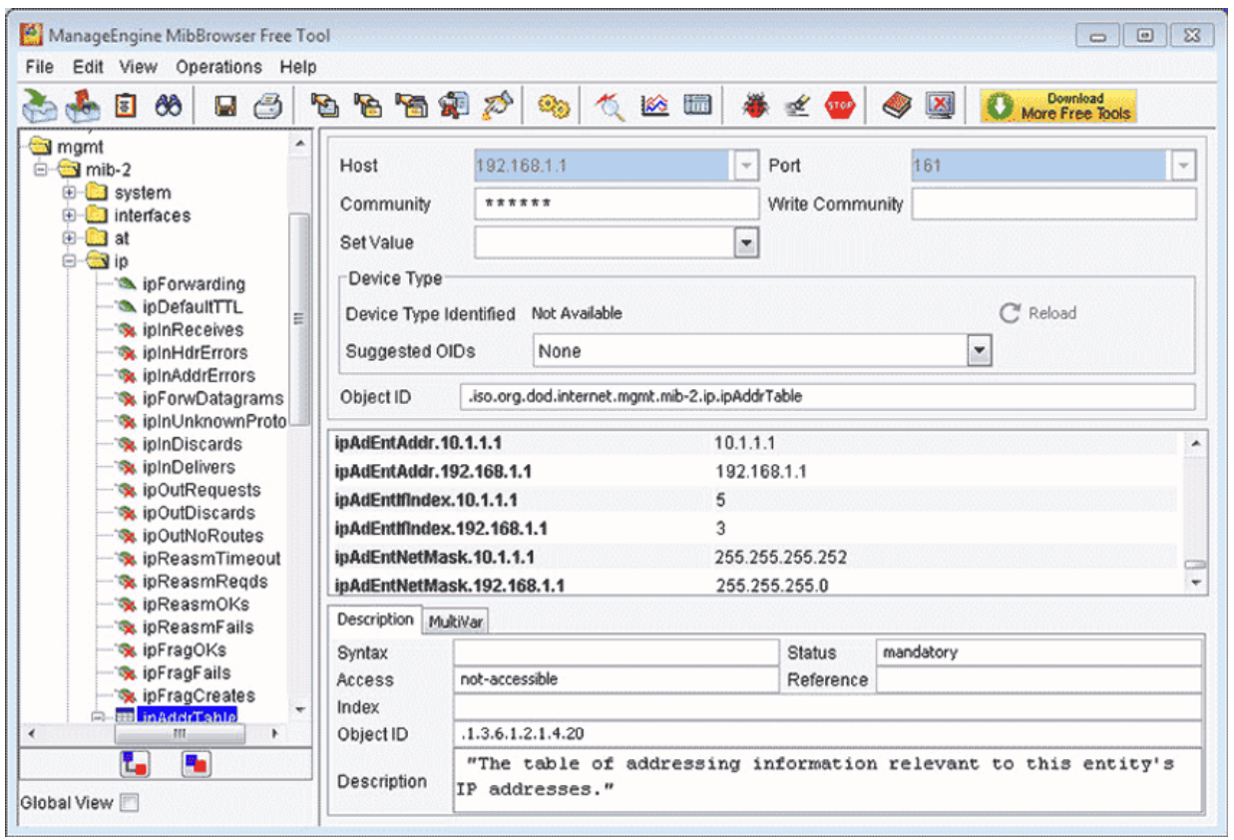
SNMP Configuration
SNMPv3 Verification (Cont.)
In the figure below, the network administrator entered the OID for the IP addressing table. The get request returned all the addressing information for R1. The network administrator authenticated with the appropriate credentials.
Notes:
6: Device Monitoring and Management 6.7: SNMP Configuration 6.7.10: Verifying the SNMPv3 Configuration

Slide 69
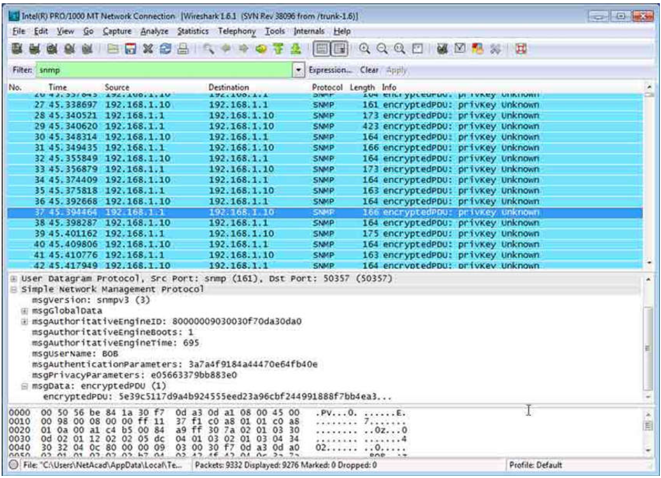
SNMP Configuration
SNMPv3 Verification (Cont.)
Verify that the data was encrypted by running a protocol analyzer, such as Wireshark, and capture the SNMP packets.
Notes:
6: Device Monitoring and Management 6.7: SNMP Configuration 6.7.10: SNMPv3 Verification

Slide 70
SNMP Configuration
Lab - Configure Cisco IOS Resilience Management and Reporting
In this lab, you will complete the following objectives:
Part 1: Configure basic device settings.
Part 2: Configure SNMPv3 security using an ACL.
Part 3: Configure a router as a synchronized time source for other devices using NTP.
Part 4: Configure syslog support on a router.
Notes:
6: Device Monitoring and Management 6.7: SNMP Configuration 6.7.11: Lab - Securing the Router for Administrative Access

Slide 71
SNMP Configuration
Packet Tracer - Configure Cisco Devices for Syslog, NTP, and SSH Operations
In this Packet Tracer activity, you will complete the following objectives:
Part 1: Configure Syslog Service
Part 2: Generate Logged Events
Part 3: Manually Set Switch Clocks
Part 4: Configure NTP Service
Part 5: Verify Timestamped Log
Notes:
6: Device Monitoring and Management 6.7: SNMP Configuration 6.7.12: Packet Tracer - Configure Cisco Routers for Syslogn NTP, and SSH Operations

